Slide 1


Understanding Digital Economy Dilemmas:
Using Systems Thinking
Roadmap
Systemic Digital Economy Dilemmas
Systems Thinking & Complexity
Aligning Digital Economy Dilemmas to ST
Prof. Nixon Muganda Ochara
Chair – Digital Business
Wits Business School
E-Mail: Nixon.Ochara@wits.ac.za

Slide 2
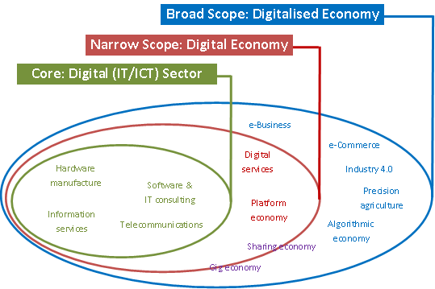
1. “Systemic” Digital Economy Dilemmas
What is the Digital Economy?
The United Nations defines the Digital Economy as the economic activities that result from billions of everyday online connections among people, organizations, devices, data and processes.
Source: https://diodeweb.files.wordpress.com/2017/07/digital-economy-three-scopes.png

Slide 3



1. “Systemic” Digital Economy Dilemmas
1.1 Interconnectivity and the Share Economy
Today’s internet will be supplemented
by a space-based internet with global
scope.
Communications via shared global
media contributes to leveling social aspirations and decreasing
knowledge disparities.
Why the Share Economy is Really the “Share-the-Scraps” Economy
Source: https://www.linkedin.com/pulse/why-share-economy-really-share-the-scraps-robert-reich
Notes:
The global community is increasingly being facilitated by Industry 4.0 technologies, resulting in higher levels of socio-political and economic interdependence (Friedenthal et al., 2021).
The increased global interdependence subsequently incites the need for sharing of resources and the interconnection of systems in global partnerships (Friedenthal et al., 2021).
The interconnected world has seen the rise of new economic business models such as the “sharing economy”, whose focus is on the sharing of unused or underutilized capacity.
Thus, the “Sharing Economy” (SE), is yet another economic concept seen to be instrumental for realizing sustainable development.
SE is conceptualized as a subset of CE and with a bottom-up dynamic focusing on peer-to-peer (P2P) exchanges for renting goods and services over the Internet (Ganapati & Reddick, 2018b).
While there is evidence that the sharing economy exists, critics view it as a questionable phenomenon that threatens existing markets and institutions.
That the evidence of success of the sharing economy is limited to a few large commercial ‘sharing’ platforms; with these platforms increasingly interfering with the status quo of certain economic sectors, leading to conflicts (Codagnone & Martens, 2016).
There are a number of criticisms of SE: Slee (2017) dismisses it as a much more punishing form of capitalism characterized by deregulation, entitled consumerism for the wealthy, and precarious work arrangements.
That, while SE emphasizes the sharing and renting of assets, the actual ‘rents’ charged go to the owners of the assets; hence, wealth still accumulates to those who own property resulting in the alienation of others (Ganapati & Reddick, 2018b).
Srnicek (2017, p. 254) labels it as “platform capitalism”, an economic model with a “voracious appetite for data that can only be sated by disregard for privacy (and often workers' rights), and constant outward expansion.”
Therefore, on the downside, the rental emphasis of the sharing economy could exacerbate inequality (social exclusion) by privileging those who own property already.
Reich ( 2015) dismisses SE as a “share-the-scraps-economy” where, “human beings do the work that's unpredictable and patch together barely enough to live on.”
That, in this “share-the-scraps-economy”, what is emerging is a new “precariat” labor class that is flexible but without work security (Standing, 2018).
Thus, while SE is touted as a panacea to a globally interconnected world, the downsides point to a systemic dilemma ‘weighed’ down by a darker side.
Borrowing from Buhalis et al., (2020) the dilemma is akin to seeking a balance between value co-creation and value co-destruction in the sharing economy.

Slide 4


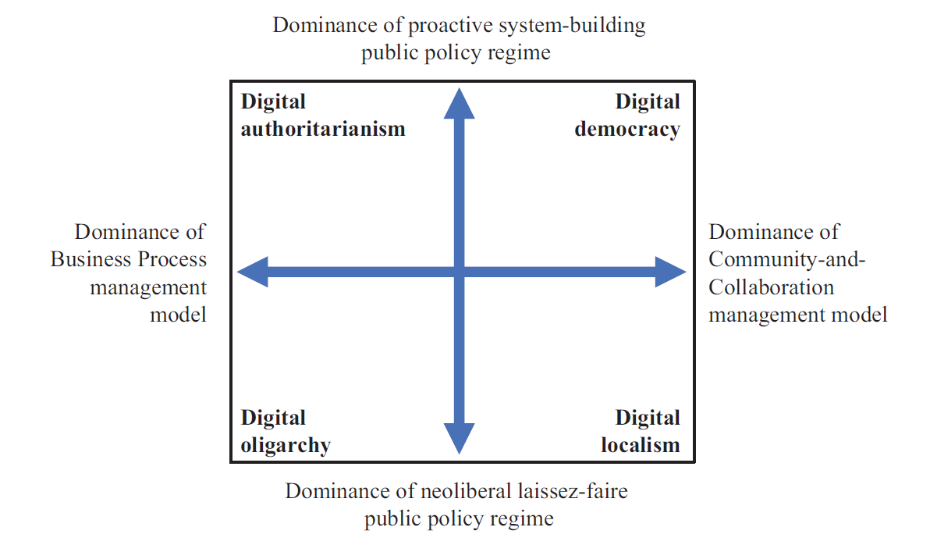
1. “Systemic” Digital Economy Dilemmas
1.2 Digital Transformation & Social Exclusion
Digital representations of systems will enable the exploration of design and margins (physical as well as performance and safety) using virtual reality and/or augmented reality, including highly immersive environments.
Increased reliance on digital representations will require
cyber-security diligence in order to protect data and intellectual property.
“Creative Destruction” and the Curse of Social Exclusion
Bodrožić, Z., & S. Adler, P. (2022). Alternative futures for the digital transformation: A macro-level Schumpeterian perspective. Organization Science, 33(1), 105–125.
Notes:
Digital Transformation (DT) is a new "linguistic device" for Industry 4.0/5.0 technological revolution.
DT is a "linguistic device" because its expectations and outcomes/reality are conflicting, but its legitimacy is sound, given the global mobilization of investments linked to DT's activities.
This points to a systemic dilemma because of its contradictory effects and benefits. Bodrožić & S. Adler (2022) point to four competing future trajectories of DT development (Figure 1): digital authoritarianism, digital oligarchy, digital localism, and digital democracy.
Bodrožić & S. Adler (2022) distinguish these DT outcomes: Digital authoritarianism blends proactive system-building and business process management with digital technology investments and execution to generate public value. Digital authoritarianism places technological sovereignty in the hands of a small number of powerful state elites and is characterized by a hierarchical organizing principle, suppression of communities, surveillance, and control. Diverse countries have justified the efficacy of digital authoritarianism in countering terrorism, COVID-19 outbreak, civil unrest, and war (Bodrožić & S. Adler, 2022; Dragu & Lupu, 2021; Ibezim-Ohaeri, 2022; Polyakova & Meserole, 2019). A digital oligarchy is a DT scenario in which a wealthy few dominate technology investments and deployment under a neoliberal laissez-faire regime (Bodrožić & S. Adler, 2022). Digital oligopolies actively set the trajectory of DT (Amazon, Facebook, Google, etc.); extensive diffusion of the business process model, underlined by a "Winner-Takes-It-All" logic with strong network effects; commercial surveillance and monetization of data; censorship and free speech are a matter of corporate private policy (Andriole, 2017; Bodrožić & S. Adler, 2022). Berardo (2022) contends that as humanity becomes 'hyper-technological,' the digital oligarchy will become a new type of authority with little accountability. Positively, digital oligarchies can also become platforms for democratizing processes used for the creation of communities and for e-participation.
Digital localism proceeds by combining a laissez-faire national public policy regime, with a range of local management models, resulting in a patchwork pattern of technological investments and development (Bodrožić & S. Adler, 2022). A key impetus for the drive towards localism policies is the incorporation of ‘public access’ as a critical dimension of digital inclusion of diverse groups to DT technologies and applications (Fuentes-Bautista, 2014). Here, the Internet plays a key role in enabling ‘public access’ by making it easier to ‘network’ from below. Primary characteristics of digital localism embrace a laissez-faire public policy where the government plays a minimal role in shaping the DT trajectory; local jurisdictions may favor community-and-collaboration model for building community wealth; the local community may be given technological sovereignty for deployment of digital technologies; digital localism forgoes the potential benefits of scale and interconnectivity at the national level (Bodrožić & S. Adler, 2022). A digital democracy scenario blends a proactive system-building regime with a management paradigm based on community and collaboration (Bodrožić & S. Adler, 2022). Notable characteristics of a digital democracy in its role of development and deployment of technology include: the formal systems of government play an enabling role and fosters community initiatives; technological sovereignty is placed in the hands of citizens; collective decision making is sought to be more engaging, inclusive and responsiveness to participants opinions; duality of the need to govern actors to make the democratic process manageable versus the pressure for social actors to make it more equal and inclusive persists (Bodrožić & S. Adler, 2022; Brill, 2021; Deseriis, 2021).
The envisaged dilemmas of DT are couched in the Schumpeterian notion of ‘creative destruction’, which in this instance, is linked to the instability and the emergence of new forms of economic cycles generated by technological development and deployments. For instance, Fuchs (2021) identifies ten major societal problems linked to digital capitalism, a new and prevalent feature of the dominant trajectories of DT, yet for Habermas, the public sphere has a democratic, non-capitalist and unideological character. But everybody knows that the Internet, social media, and new digital technologies are potentially harmful to democratic life. However, the question to ask is who is controlling the DT process, and what does it portend for deepening social inequalities linked to technological progress (Sama et al., 2021). Digital democracy provides a path to DT development and deployment, but no country has so far embraced the digital democracy scenario. Thus, realizing DT becomes a dilemma, as the three forms of alternative scenarios (digital authoritarianism, digital oligarchy, and digital localism) to not provide a clear path to success.
Creative destruction describes the deliberate dismantling of established processes in order to make way for improved methods of production

Slide 5
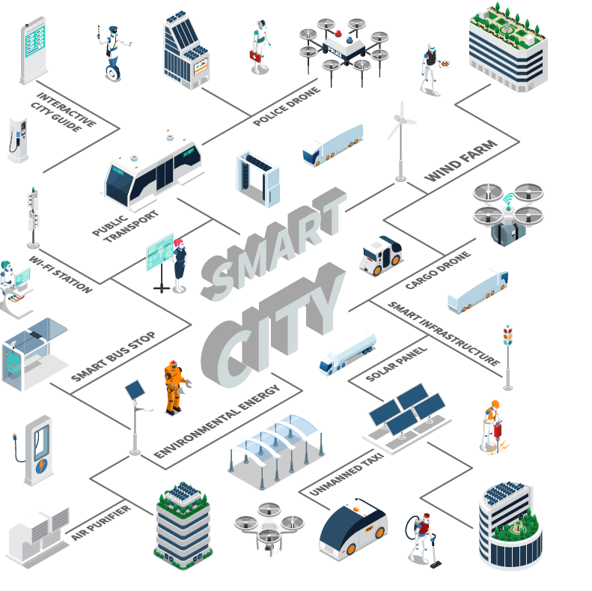
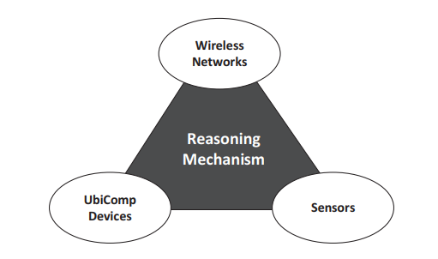
1. “Systemic” Digital Economy Dilemmas
1.3 Proliferation of Smart Systems
“Synthetic” Design of Smart Systems?
Source: Lupiana, D., O’Driscoll, C., & Mtenzi, F. (2009). Defining smart space in the context of ubiquitous computing. Ubiquitous Computing and Communication Journal. Special Issue on ICIT 2009 Conference--Web and Agent Systems.
Notes:
Yochai Benkler: We are bewitched with concepts.
SMART SYSTEMS PROLIFERATE:
Smartness involves purposeful creation of devices, Smartness involves deliberate creation of gadgets, sociotechnical systems, and fully automated systems leveraging Industry 4.0 technology (Alter, 2020).
Smart systems can update their internal knowledge used for reasoning to make optimum decisions (Romero et al., 2020). Smart systems (smart homes, smart cities) combine sensory and computational technologies to gather huge volumes of information, which is input into a reasoning mechanism.
A critical attribute of smart systems is user mobility, that is, the ability of the (smart) environment to continuously provide access to computational tasks and resources anywhere and everywhere in that environment (Pascual et al., 2019).
To support user mobility, the reasoning mechanism of smart systems is supported by three components: wireless networks, ubiquitous computing (Industry 4.0) devices, and sensors.
Emerging from principles of pervasive computing, smart systems in agriculture, urban complexes, homes, appliances, health, financial services, energy, telecommunications, private and public transportation, and national security are proliferating internationally (Romero et al., 2020).
To link the dilemmas associated with smart systems to flexible modularization, an understanding of the design principles of Industry 4.0 is critical.
Hermann et al., (2016) identifies six critical principles for designing Industry 4.0: interoperability, virtualization, decentralization, real-time capability, service orientation and modularity.
Incorporating these design principles for Industry 4.0 will give rise to smart systems (and its elements) with the following characteristics: communication capability, embedded knowledge, learning capability, reasoning capability, perception capability and control capability.
However, these smart systems are not static, and as the systems elements interact to exhibit the characteristics above, new characteristics and properties emerge.
Thus, smart systems must also have the capability to self-organize, as the emergent characteristics ‘forces’ the system to modify it structure, while keeping to the original goal. Using sensory devices, the smart system must also be context-aware of the environment it is operating in.
Embedding the design principles above into smart systems, with the characteristics of interoperability, virtualization, decentralization, real-time capability, service orientation and modularity, imply that they emerge as complex, open and dynamic systems.
Contemporary methods to system design are still immersed in a "functional top-down design" paradigm founded on the false idea that complex systems design can be "managed." Valckenaers et al., (2003) argue that control in the design of complex systems is illusionary and that 'object-oriented design' moored on 'synthetic' reasoning is appropriate in VUCA situations.
Adopting synthetic thinking in the design of complex smart CPS, based on Hermann et al., (2016)’s, systems design principles, is still a global dilemma.
The 'Dilemma of Synthetic Design' describes the boundaries of existing smart system design ideas.
The "Dilemma of Synthetic Design" challenges the limits of analytical thinking in designing complex systems.

Slide 6
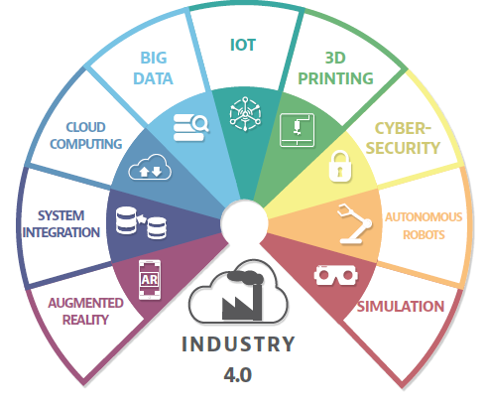
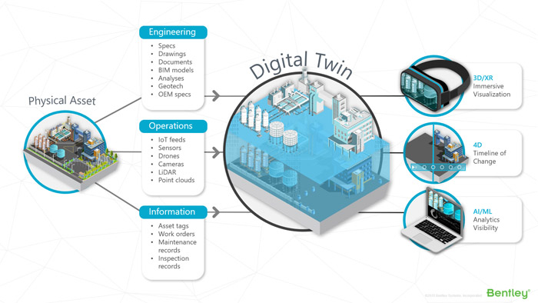
1. “Systemic” Digital Economy Dilemmas
1.4 Industry 4.0/5.0 & Cyber-Physical Systems
Under the Industry 4.0 approach, the logic and control of production changes significantly, and form the basis for smart factories.
Society 5.0 explicitly looks to a future of socio cyber-physical systems.
That is, a human-centered society that balances economic advancement with the resolution of social problems by a system that highly integrates cyber-space and physical space.
In Society 5.0, data from sensors in physical space are accumulated in cyber-space, analyzed by artificial intelligence (AI), and results are fed back to humans in physical space in various forms.
Digital Twins for Cyber-Physical Systems?
Source: https://aecmag.com/features/discussing-digital-twins/
Notes:
The belief that sustainable development deeply relies on technological development is a long-held view, despite criticism the conceptualization of the link is neoliberal and Eurocentric in orientation (Schelenz & Pawelec, 2022).
Despite such criticism, it is nevertheless considered critical to implement innovative technologies as a significant driver for establishing a proactive, self-configured and automated system for realizing sustainability goals.
These innovative technologies, under the umbrella of the concept of Industry 4.0, refers to the evolution of industries towards cyber-physical systems; and Society 5.0, evolution of the society towards socio-cyber-physical systems (Friedenthal et al., 2021).
The purpose of Industry 4.0 is the optimization of production in the productive sectors using integrative and interconnected technologies of Industry 4.0 (Berawi, 2019; Dantas et al., 2021; Ramakrishna et al., 2020).
However, how to achieve integration and interconnection of the core technologies of Industry 4.0 is still unclear.
Possible reasons for the challenge of integration are linked to lack of training and skills, Industry 4.0 conceptual ambiguity, inadequate policies, lack of government support, lack of a unified approach in the implementation of Industry 4.0, vast differences in levels of maturity in the Industry 4.0 technologies and unique emerging markets challenges whose economies are labor-intensive (Hughes et al., 2022; Pourmehdi et al., 2022; Suleiman et al., 2022) .
These challenges create dilemmas for decision makers to effectively transition to Industry 4.0 technologies.
Thus, while there is strong evidence that shows the connection between Industry 4.0 and sustainable development, the identified impediments create hurdles for the realization of its agenda, thus creating decision making dilemmas.
For instance, while digitalization is considered beneficial to a business, additional considerations such as the cost of extra energy, more use of resources and harmful emissions could be some of the consequences associated with the adoption of Industry 4.0 technologies (Bai et al., 2020).

Slide 7


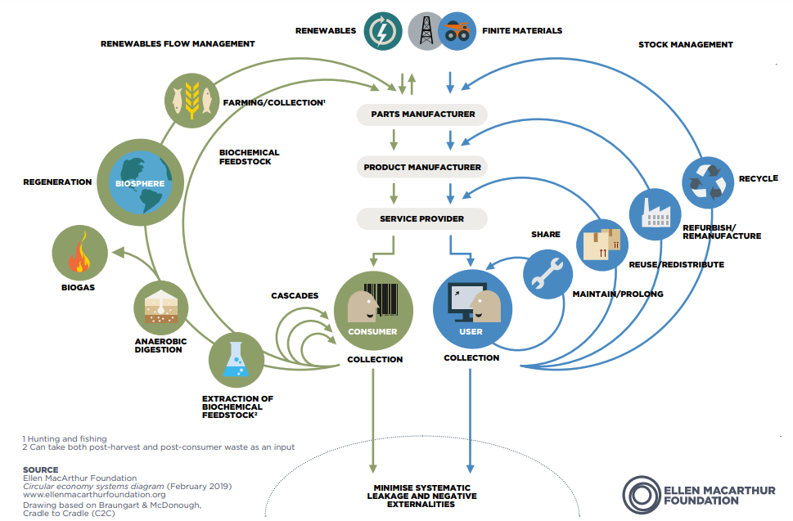

1. “Systemic” Digital Economy Dilemmas
1.4 Environmental Sustainability
Many systems, will arise to mitigate the deleterious impacts of climate change, such as global warming.
The global fossil fuel-based energy economy will be transformed to one based on clean and renewable sources.
The Circular Economy, a Solution?
Priority will be placed on systems that are more efficient at resource utilization and responsible waste disposal.
Notes:
Sustainability is viewed as humanity’s attempt to correct the mistakes of the past to ensure the survival of planet earth.
Under the megatrend of “sustainability”, humanity recognized that it is facing astounding challenges ranging from environmental (climate change, air quality issues, waste accumulation), economic (unemployment, economic inequality), and social (food security, water scarcity, and poverty) challenges (Zander & Mosterman, 2013).
As a result, and following the failure of millennium development goals (see McCloskey, 2015), a new international agenda for development was adopted in September 2015 under the auspices of the United Nations 2030 Agenda for Sustainable Development (Johnston, 2016).
However, what is much less clear is the dilemmas faced by humanity as they strive towards the attainment of the 17 SDGs.
Two new discourses on the Circular Economy (CE) and Industry 4.0 are being promoted as significant systemic transformations that have the potential to contribute to the achievement of the 17 SDGs.
CE advocates for an economic system that detaches environmental pressure from economic growth through the replacement of linear production for circular production where waste becomes a resource (Belmonte-Ureña et al., 2021; Sanguino et al., 2020).
The current system is based on the linear logic that has supported global industrial development in the last few decades (de Souza Junior et al., 2020).
It is based on the large-scale extraction, use, and disposal of materials, which is the source of many intergenerational and intergovernmental problems, such as waste disposal in natural areas, lack of resources, and climate change (Korhonen et al., 2018).
The proposed CE paradigm is defined as a “regenerative system in which resource input and waste, emission, and energy leakage are minimized by slowing, closing, and narrowing material and energy loops.
This can be achieved through durable design, maintenance, repair, reuse, remanufacturing, refurbishing, and recycling” (Geissdoerfer et al., 2017, p.759).
Thus, CE has emerged as strategic response to sustainability challenges to the limits of a linear economy, and promotes a circular rationale focused on a “zero waste economy” (van Langen et al., 2021).
While advocates advance CE as a practical solution to sustainability challenges, critics point to the concept’s questionable theoretical, practical, and ideological foundations.
The generic critique is that CE is a vague, uncontroversial reassuring discourse for policy makers to use as a buzzword for sustainable development; however, the circular future is not mapped out while questions abound as to how to disrupt contemporary social institutions that have evolved using the linear rationale (Corvellec et al., 2022).
The critics of CE recommend a much more modest conception of the potentials of CE, with a focus on actual solutions to actual problems; concreteness in the type of circularity being implemented; transparency and accountability for achievements and shortcomings of CE (Corvellec et al., 2022).
The two opposing views show that there is a dilemma.
On the one hand, people who believe in CE imagine a sustainable future based on planned circularity, circular modernism, bottom-up sufficiency, and peer-to-peer circularity.
On the other hand, people who don't believe in CE say that it is a myth that "paints" a "utopian" future (Bauwens et al., 2020; Corvellec et al., 2022).

Slide 8
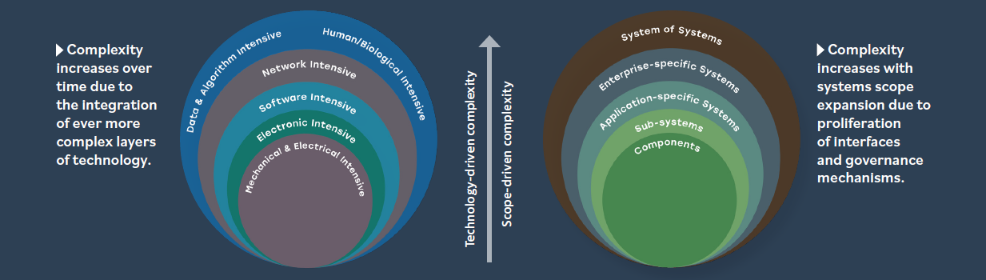
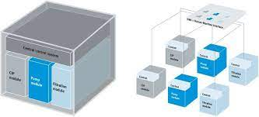
1. “Systemic” Digital Economy Dilemmas
1.5 Increasing Global Systems Complexity
Flexible Modularization for Distributed Eco-Systems?
Source: https://www.festo.com/cms/en-ae_ae/71024.htm
Notes:
SYSTEM COMPLEXITY EXPLODES:
The general view is that global complexity, comprising of five critical sub-systems of the ecological system; economic system; technological system; social system; and the political system, has spun out of control and has outgrown global governance mechanisms that were enacted after the second world war in 1945 (Schwab, 2019).
That current global systems are always 'on the edge of chaos', with the "'normal" state of nature far from that of balance and repose, but that which demands recovery and rebalancing from the last disaster (Budiansky & Pimm, 1995; Urry, 2005).
As the Industry 4.0 continues to evolve, there is also a commensurate increase in global systems complexity in two main aspects/dimensions (Figure 7): technology-driven complexity due to the different layers of 4IR technologies; and scope-driven complexity due to the proliferation of systems interfaces and governance mechanisms (Friedenthal et al., 2021).
Other drivers of global systems complexity are linked to increased demand for greater systems capability and efficiency and improved systems adaptability due to context-awareness of application and increased autonomy.
Global system complexity is visible in the evolution to complex systems such as smart houses, modern automobiles, household appliances, energy networks, precision medicine, etc.
If living on the ‘edge of chaos’ has become “normal”, achieving rebalance must consider newer approaches that deal with huge amounts of distributed components, heterogeneity of global systems, problem size and dynamic changes of the environment (Šešum-Čavić, 2019).
To address the increase in global system complexity, various concepts have emerged to explain humanity’s response to dilemmas arising from systemic complexity.
Certainly, from the design and architecting of complex system, modularization is at the fore of addressing systemic complexity.
For instance, Gärtner & Schön (2016), emphasizes that modularization of business models emphasizes a set of decisions that allows and organization to develop capability to adjust flexible and resiliently to environmental turbulence using product modularity, channel modularity, pricing modularity, asset and capability modularity and partner modularity.
However, despite modularization being advanced as a way of handling systemic complexity, the difficulty of determining what constitutes an adequate modularization of a complex system has received little consideration(Ethiraj & Levinthal, 2004) .
Realizing modularization is still a dilemma, as designers of complex systems are normally faced with trade-off between the destabilizing effects of overly refined modularization and the modest levels of search and a premature fixation on inferior designs that can result from excessive levels of integration (Ethiraj & Levinthal, 2004).
Apart from trade-offs linked to the process of modularization, its nature is still taking shape, with different conceptualizations.
For instance, Micheli et al., (2019) puts forward an ontology of modularization as a system lifecycle management strategy, and not merely as a design issue inimical of the architecting of systems.
Persistent challenges and global system complexity point to modularization being a dilemma that decision makers at all levels of society are still grappling with. points to a dilemma that is persistent, thus resolving to a strategic decision that, by its very nature, has consequences on the whole system’s life cycle.
EXAMPLES:
SMART HOUSES containing heating, air-conditioning, lighting, and security subsystems, controlled by smart thermostats
and a spectrum of sensors, which are frequently connected to the internet and mobile phones, to optimize energy consumption, comfort, safety, and other functions.
2. MODERN AUTOMOBILES incorporating intelligent navigation systems and multiple controllers for advanced driving assistance systems, power management, suspension management, and many more subsystems each of which is highly complex in its own right.
3. ENERGY NETWORKS that are necessarily systems of systems, consisting of geographically and managerially distributed
elements comprising generation, transmission and distribution, supported by intelligent sensors, energy management processors, and sophisticated logistical and cyber-security systems.

Slide 9
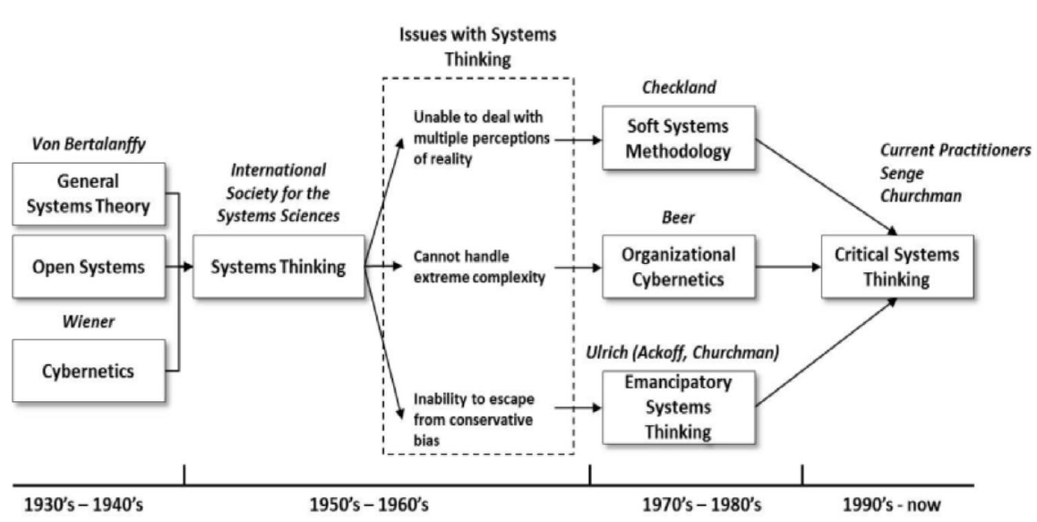
2. Systems Thinking Evolution
2.1: From Reductionist to Systems Thinking
Systems Thinking Evolution
Source: Evolving view of Systems Thinking from The Evolution of Systems Thinking by Jorge Taborga - https://insightmaker.com/insight/1971/Systems-Thinking-Evolution last accessed May 2022

Slide 10
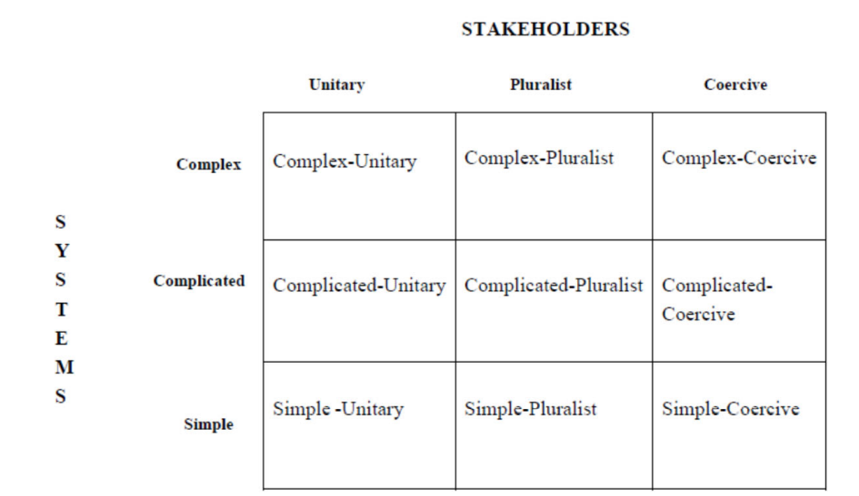
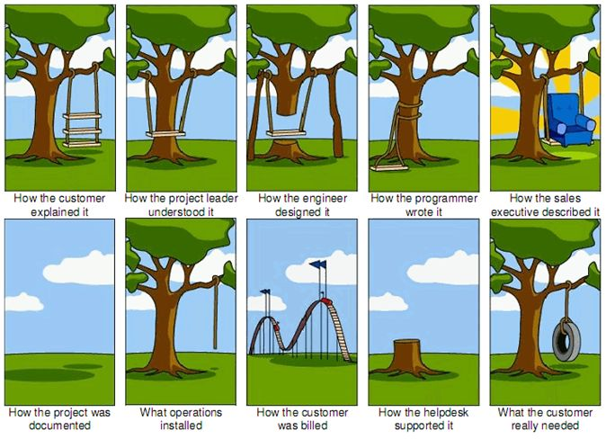
2. Systems Thinking Evolution
2.2 Complexity in Decision Scenarios
Requirements Engineering?
Source: Jackson, M. C. (2020). How we understand “complexity” makes a difference: Lessons from critical systems thinking and the Covid-19 pandemic in the UK. Systems, 8(4), 52.
Thesis of the Paper: Understanding dynamic complexity requires multiple perspectives rooted in Systems Thinking.
Notes:
"System of Systems Methodologies" (SOSM), established in 1984, is often used to comprehend complexity (Jackson & Keys, 1984).
The SOSM is presented as a grid (Table 4) featuring "systems" and "stakeholders" as the key sources of complexity that decision makers face (Jackson 2020).
The vertical axis depicts system complexity from simple to complex. A simple system has a linear cause-and-effect relationship with predictable outputs.
Such a system needs best practices or simple ways for decision-making (Jackson 2020).
In complicated systems, cause and effect relationships are often linked in chains that are hard to grasp and are separated in time and space.
Decision making scenarios where there are complicated systems require the use of experts who can help understand the behavior of the system using systems thinking tools such as system dynamics.
In complex systems, there are a multitude of agents and relationships that it is impossible to trace the interactions and outcomes.
However, despite the innumerable cause and effect concatenations, the system normally produces emergent patterns of behavior that can be discerned in retrospect (Jackson 2020).
The horizontal axis shows increasing complexity from diverging values and/or interests among problem stakeholders. The terms “unitary”,” pluralist”, and” coercive” are employed.
"Unitary" stakeholders share values, beliefs, and interests. "Unitary" stakeholders share values, beliefs, and interests.
In a "pluralist" relationship, values, and beliefs clash, but basic interests are compatible.
Divergent interests and irreconcilable values and beliefs exist among "coercive" stakeholders.
Combining systems and stakeholder dimensions yields nine "ideal-type" problem contexts (Table 6).
The “Ideal-Type” grid is next used to map aspects of five digital economy dilemmas identified earlier.
Using the "Ideal-Type" grid, it is practical to adopt an approach that delineates the nature of the problem by considering, first, the system's characteristics/properties and, second, whether the system's stakeholders have shared or conflicting interests.
Given the above characterization of digitalization dilemmas, the critical question is: what systems thinking techniques can be used to better understand and resolve these dilemmas?

Slide 11
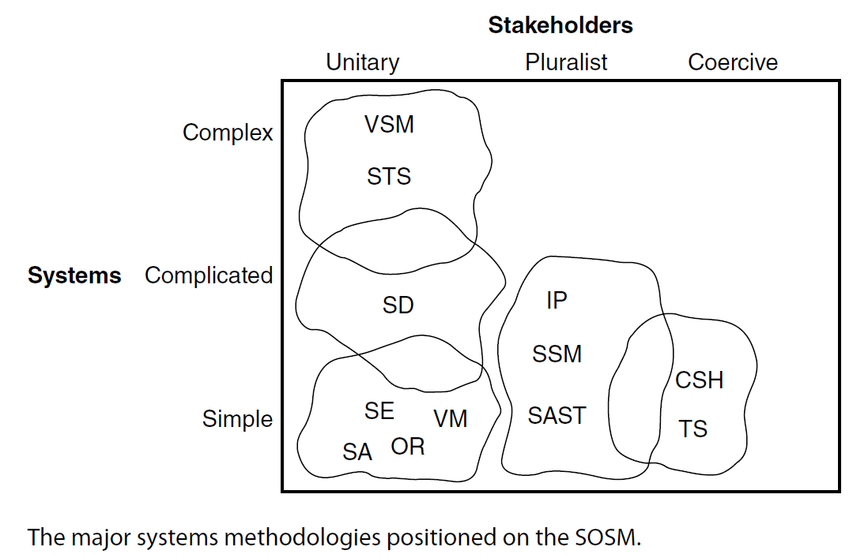
2. Systems Thinking Evolution
Systems Thinking is the fusion of analysis and synthesis.
Notes:
Early approaches to applied systems thinking, such as operational research (OR), systems analysis, and systems engineering, were suitable for tackling well‐defined problems of a technical nature, but were found to have limitations when faced with complex problem situations involving people with multiple perspectives and frequently at odds with one another.
Given the complexity, turbulence, and diversity of most problem situations confronting decision‐makers in the twenty‐first century, it is hardly surprising that no one systems approach can supply the answer.
CST sets out how the variety of systems methodologies, methods, and models that have been developed can be used in combination to promote more successful interventions in complex organizational and societal problem situations.

Slide 12
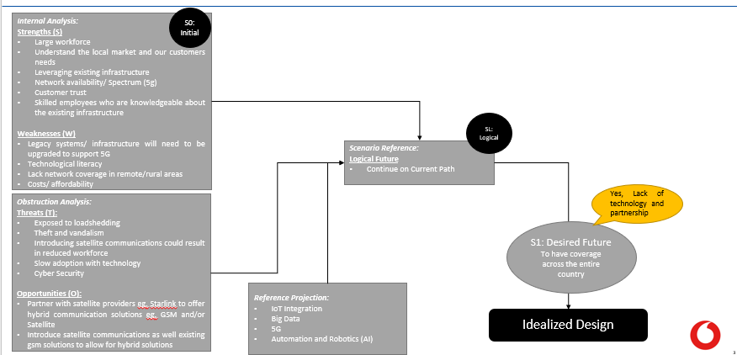
3. Aligning DE Dilemmas to ST
3.1 ST in “Idealized” Design Situations e.g. Smart Environments
Used in creating visions of a desired future
Notes:
"System of Systems Methodologies" (SOSM), established in 1984, is often used to comprehend complexity (Jackson & Keys, 1984).
The SOSM is presented as a grid (Table 4) featuring "systems" and "stakeholders" as the key sources of complexity that decision makers face (Jackson 2020).
The vertical axis depicts system complexity from simple to complex. A simple system has a linear cause-and-effect relationship with predictable outputs.
Such a system needs best practices or simple ways for decision-making (Jackson 2020).
In complicated systems, cause and effect relationships are often linked in chains that are hard to grasp and are separated in time and space.
Decision making scenarios where there are complicated systems require the use of experts who can help understand the behavior of the system using systems thinking tools such as system dynamics.
In complex systems, there are a multitude of agents and relationships that it is impossible to trace the interactions and outcomes.
However, despite the innumerable cause and effect concatenations, the system normally produces emergent patterns of behavior that can be discerned in retrospect (Jackson 2020).
The horizontal axis shows increasing complexity from diverging values and/or interests among problem stakeholders. The terms “unitary”,” pluralist”, and” coercive” are employed.
"Unitary" stakeholders share values, beliefs, and interests. "Unitary" stakeholders share values, beliefs, and interests.
In a "pluralist" relationship, values, and beliefs clash, but basic interests are compatible.
Divergent interests and irreconcilable values and beliefs exist among "coercive" stakeholders.
Combining systems and stakeholder dimensions yields nine "ideal-type" problem contexts (Table 6).
The “Ideal-Type” grid is next used to map aspects of five digital economy dilemmas identified earlier.
Using the "Ideal-Type" grid, it is practical to adopt an approach that delineates the nature of the problem by considering, first, the system's characteristics/properties and, second, whether the system's stakeholders have shared or conflicting interests.
Given the above characterization of digitalization dilemmas, the critical question is: what systems thinking techniques can be used to better understand and resolve these dilemmas?

Slide 13
3. Aligning DE Dilemmas to ST
3.2: ST in “Coercive” Complexity
Boundary Questions: Making sense of situations: understanding assumptions and appreciating the bigger picture.
Boundary Questions: Create awareness about:
SOURCES OF MOTIVATION: Values and motivations built into our views of situations and efforts to ‘improve’ them.
SOURCES OF CONTROL: Power structures influencing what is considered a ‘problem’ and what may be done about it.
SOURCES OF KNOWLEDGE: The knowledge basis defining what counts as relevant ‘information’, including experience and skills.
SOURCES OF LEGITIMACY: The moral basis on which we expect ‘third parties’ (i.e., stakeholders not involved yet in some way concerned) to bear with the consequences of what we do, or fail to do, about the situation in question.
Jackson, M.C. (2019). Critical Systems Thinking and the Management of Complexity; Wiley: Chichester, UK
Notes:
Boundary Questions:
The boundary questions try to make sense of a situation by making explicit the boundaries that circumscribe our understanding.
Such boundaries inform all our thinking about situations and systems; they constitute what in CSH we call our ‘reference
systems’ (a concept to be introduced a little later).
Broadly speaking, the boundary questions may be understood to cultivate a more holistic awareness of situations with regard to these wide-ranging issues:
–– Values and motivations built into our views of situations and efforts to ‘improve’
them
–– Power structures influencing what is considered a ‘problem’ and what may be
done about it
–– The knowledge basis defining what counts as relevant ‘information’, including
experience and skills; and
–– The moral basis on which we expect ‘third parties’ (i.e., stakeholders not involved
yet in some way concerned) to bear with the consequences of what we do, or fail
to do, about the situation in question.
In CSH, these four dimensions of problems or problem situations are called sources
of motivation, of control, of knowledge and of legitimacy, respectively (see column
‘sources of influence’ in Table 6.1). In sum, the 12 questions prompt an understanding
of the ‘bigger picture’.

Slide 14
Digital Education: South Africa
1.Digital Education Platform: The Boundary Critique
 | Sources of Motivation
What (Stakes) | Purpose: What is the purpose of the current system? To educate students for employment. What ought to be the purpose of the system? To educate students to create jobs based on the worldview that innovation and technology should drive education.
Who (Stakeholders) | Beneficiary: Who is the intended beneficiary of the system? University education is elitist or for the elite in society. Who is the intended beneficiary of the system? University education should target the masses for the purpose of creating wealth for communities.
Key Issues (Stakeholding) | Measures of Success: What is the built-in measure of success? Student throughput and employability. What ought to be the measure of success? Intellectual Property (IP), innovations and number of established businesses from alumni.
Boundary Questioning:
Relevance: While the adopted approach is contextually relevant since job creation can reduce poverty levels, there maybe long lead times from completing studies to creating sustainable ventures.
Justification: While university education for the masses is laudable, not all aspire for university education, or may not have the aptitude for such education.
Ethical Defensibility: There are various entities who require graduates to be employed as accountants, lawyers, etc. Therefore, the model proposed may only work for a section of the population.
Notes:
relevance, justification and ethical defensibility.

Slide 15
Digital Education: South Africa
1.Digital Education Platform: The Boundary Critique
 | Sources of Control
What (Stakes) | Resources: What conditions of success are under the control of the system? Student throughput. What conditions of success ought to be under the control of the system? Registration of IP, new Innovations, part ownership of businesses to generate income.
Who (Stakeholders) | Decision Maker: Who is in control of the conditions of success? DHET, University Administrators. Who ought to be in control of the conditions of success of the system? Community, Education Service Providers, Students.
Key Issues (Stakeholding) | Decision Environment: What conditions of success are outside the control of the decision makers? National legislation, curriculum in high schools, national system of education. What conditions of success ought to be outside the control of the decision makers? Curriculum of high schools.
Boundary Questioning:
Relevance: A focus on innovations as the metric for educational outcomes identification of prospective students who have an affinity for entrepreneurship. This may only be relevant for those who already have a tertiary level of education.
Justification: Awareness regarding the role of universities in community life is unclear or uncharted.
Ethical Defensibility: Curriculum design at the hands of private or a non-state actor may bias other social objectives of government.

Slide 16
Digital Education: South Africa
1.Digital Education Platform: The Boundary Critique
 | Sources of Knowledge
What (Stakes) | Expertise: What are relevant knowledge and skills for the system? Managing functional teams and experts in the university; conformance to national systems of education; highly rated experts in university disciplines; networking with government. What out to be relevant knowledge and skills for the system? Community networking; MVP Development Knowledge; Project Management; Design of Platform Ecosystems; Cross-Border Trade and Partnerships; Innovation.
Who (Stakeholders) | Expert: Who is providing relevant knowledge and skills for the systems? Academics, guest lecturers. Who ought to be providing relevant knowledge and skills for the system? Practitioners, Scholars, Entrepreneurs, Innovators.
Key Issues (Stakeholding) | Guarantor: What are regarded as assurances of successful implementation of the systems? Employed graduates, government funding research, increased student throughput. What ought to be regarded as assurances of successful implementation of the systems? Community innovation labs, sustainable community innovations, diversified sources of income.
Boundary Questioning:
Relevance: The lack or weak forms of national systems of innovation may first require developing content that is aligned to the values of the targeted communities. This may require heavy investment in the design of curricula from the supply-side of the digital platforms.
Justification: An assumption is made that expertise exists, with unused capacity since the digital platform model is partly based on the concept of spare capacity.
Ethical Defensibility: Innovation as the only basis for knowledge generation maybe difficult to defend, given entrenched interests..

Slide 17
Digital Education: South Africa
1.Digital Education Platform: The Boundary Critique
 | Sources of Legitimacy
What (Stakes) | Emancipation: What are the opportunities for the interests of those negatively affected to have expression and freedom from the worldview of the system? Student Representative Councils, Class representative system. What ought to be the opportunities for the interests of those negatively affected to have expression and freedom from the worldview of the system? Venture mentoring mechanisms, start-up fundings mechanisms, cooperative marketing mechanism (such as the Kibbutz in Israel; Co-operative Bank in Kenya).
Who (Stakeholders) | Witness: Who is representing the interests of those negatively affected by but not involved in the system? Parents, trade unions (for staff). Who ought to be representing the interests of those negatively affected by but not involved in the system? Community Association, Industry Sector Associations where the innovations will find a ‘home’, community mentors of the students, national and regional patent offices.
Key Issues (Stakeholding) | Worldviews: What space is available for reconciling differing worldviews regarding the system, among those involved and affected? Students’ participation in disciplinary committees What space ought to be available for reconciling differing worldviews regarding the system, among those involved and affected? Regular discourse fora, community representation in governance systems, community participation in strategic planning, social media platform for collating views.
Boundary Questioning:
Relevance: The alternative interests goes against the grain, and may demand for proof of concept.
Justification: The profit incentive of current industry associations may thwart alternative modes of thought for business model innovation..
Ethical Defensibility: Asking governments to dig deeper to setup funds for untested operating models is fraught with challenges.

Slide 18
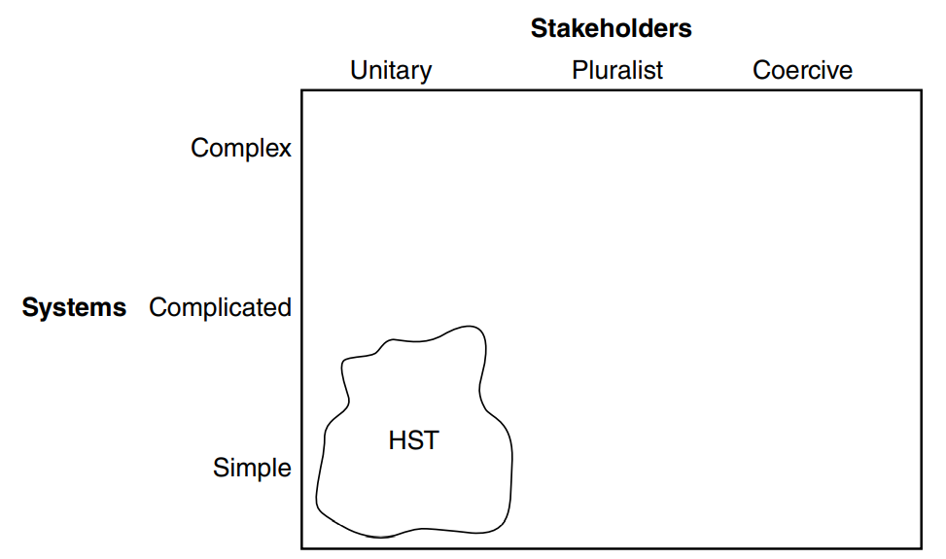
3. Aligning DE Dilemmas to ST
3.3: ST in “Technical” Complexity
In certain circumstances … a mechanical mode of organization can provide the basis for effective operation. But in others it can have many unfortunate consequences. It is thus important to understand how and why we are engaging in mechanistic thinking; and how so many popular theories and taken‐for‐granted ideas about organization support this thinking (Morgan 1986, p. 22).
Jackson, M.C. (2019). Critical Systems Thinking and the Management of Complexity; Wiley: Chichester, UK
Notes:
Boundary Questions:
The boundary questions try to make sense of a situation by making explicit the boundaries that circumscribe our understanding.
Such boundaries inform all our thinking about situations and systems; they constitute what in CSH we call our ‘reference
systems’ (a concept to be introduced a little later).
Broadly speaking, the boundary questions may be understood to cultivate a more holistic awareness of situations with regard to these wide-ranging issues:
–– Values and motivations built into our views of situations and efforts to ‘improve’
them
–– Power structures influencing what is considered a ‘problem’ and what may be
done about it
–– The knowledge basis defining what counts as relevant ‘information’, including
experience and skills; and
–– The moral basis on which we expect ‘third parties’ (i.e., stakeholders not involved
yet in some way concerned) to bear with the consequences of what we do, or fail
to do, about the situation in question.
In CSH, these four dimensions of problems or problem situations are called sources
of motivation, of control, of knowledge and of legitimacy, respectively (see column
‘sources of influence’ in Table 6.1). In sum, the 12 questions prompt an understanding
of the ‘bigger picture’.

Slide 19
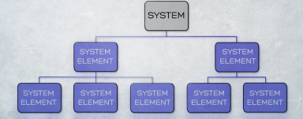
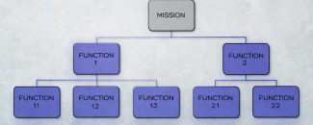
3. Aligning DE Dilemmas to ST
3.3 Logical & Physical Descriptions of Systems
In the development of a system, therefore, there are at least two architectural views: a system logical architecture, and a system physical architecture.
In a logical description of a system, the system’s mission is broken down into a hierarchical structure of its major functions.
A hierarchical description of a system shows the interconnections between the system elements.
The logical description or architecture is therefore often called a functional hierarchy, or a functional architecture.
Source: Faulconbridge, R. I., & Ryan, M. J. (2014). Systems engineering practice. Canberra: Argos Press.
Notes:
Since each of these system elements will need to perform functions allocated to it so that it can contribute to the systems mission, we can consider the system to be a hierarchical composition of system elements.
Logical (or Functional) (It is about the WHAT)– What the system will do, how well it will do it, and how it will be tested, under what conditions it will perform, and what other systems will be involved with its operation.
Physical (It is about the HOW)– what the system elements are, how they look, and how they are to be manufactured, integrated, and tested.
Both the logical and physical descriptions of a system comprise a series of statements called requirements.
The two descriptions are valid independent descriptions of a system:
We develop the logical description first.
How we implement current physical systems should not colour unnecessarily the way in which we might describe future systems.
A logical description is ideally suited to the interface between systems engineering and the business case.
The logical description changes slowly; the physical description changes mush faster. E.g. the combustion engine system has not changed much over the centuries, but how it has been implemented in cars using various technologies has been changing.
In the development of a system, therefore, there are at least two architectural views: a system logical architecture, and a system physical architecture.
These two descriptions must be related.
The logical architecture is outlined in the requirements breakdown structure (RBS), while the physical architecture as represented by the configuration items contained in the work breakdown structure (WBS).

Slide 20
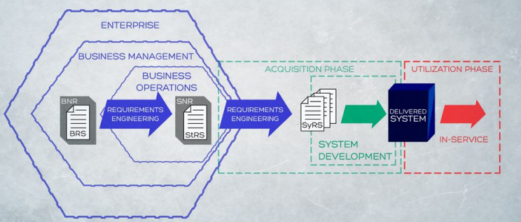
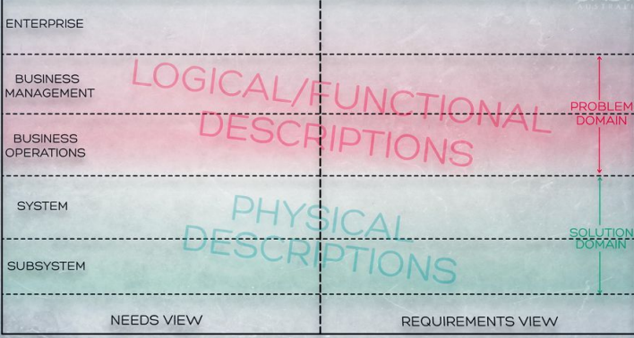
3. Aligning DE Dilemmas to ST
3.3 Requirements Engineering
Source: Faulconbridge, R. I., & Ryan, M. J. (2014). Systems engineering practice. Canberra: Argos Press.
Notes:
Needs and requirements exist at a number of levels.
As illustrated here, requirements engineering is the formal process through which we move from the enterprise strategies to the system requirements, first by formally translating the business requirements into stakeholder requirements and then the stakeholder requirements into system requirements.
There is an enterprise view (in which enterprise leadership sets the enterprise strategies and concepts of operations) or ConOps - A Concept of Operations (CONOPS) is a user-oriented document that "describes systems characteristics for a proposed system from a user's perspective.;
A business management view (in which business management derive business needs and constraints as well as formalize their requirements);
A business operations view (in which stakeholders define their needs and requirements);
A systems view (in which the system is defined in logical and physical views).
Subsequently, of course, there are the views at the lower-level of the subsystem and other system elements.
As illustrated here, the enterprise, business management, and business operations views are in the problem domain;
The system and subsystem (and lower) views are in the solution domain.
The problem domain is generally considered to be the responsibility of those who have ownership of the problem to be solved, so the descriptions of the system are predominantly in the language of the customer’s business management and business operations, focusing on what the system needs to be able to do, how well it should be done, and why— these descriptions are called logical (or often functional) descriptions.
On the other hand, the solution domain is generally considered to be the responsibility of those implementing the solution, so the descriptions of the system in that domain are predominantly in engineering and physical terms, focusing on how the problem is to be solved—that is, how it will look once it has been implemented.
These latter descriptions are called physical descriptions.

Slide 21
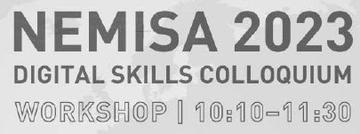
Understanding Digital Economy Dilemmas
Thank you
Notes:
Conceptual Background: Retroductive Reasoning: I am concerned, as a researcher and teacher, about the ethical concerns being raised in our society as well. As a researcher and teacher, we know that we generate knowledge through the practice of science, i.e., research. Students are always at the forefront of generating knowledge for science and practice. And, the mandatory pressure that come from the programmes they are pursuing sometimes weakens their moral compass to engage in acts of plagiarism, whether they are aware or not. Ethics in research and writing is also glossed over in most research texts, thus most research pursued by students may end up being unoriginal, which hampers the proper growth of its science, but also practices. The early claim being made is that ethics is at the heart of originality in research, thus what drives real scientific discoveries are anchored on ethics. In research and writing, ethics in research practice is therefore the anchor for novelty, importance, timeliness of a research contribution, the reason why you are doing research in the first place.
While novice researchers are faced with such ethical dilemmas related not only to the conduct of research, but also to the process of writing to produce a research output, recent technological developments have availed also ensured that there is a plethora of tools that can play the role of “research assistants”. These tools, that we will now call “Digital Research Assistants” (DRA) are any technological tool, that operates outside our mind, but can be used to enhance our cognitive and reasoning abilities. This definition is only relevant, if ethical research is being conducted. The choice of the term “Digital Research Assistants” is deliberate, to communicate the message that researcher does not need to transfer their minds to Artificial Intelligence, can use them as tools to realize the goals of science, which is the pursuit of truth. That if the researcher transfer their mind to the A.I, then creativity and originality, as the true hallmarks of research, is lost and unethical practices subsumes disciplines as plagiarism soars. That, the mind, as the factory of creativity and discovery, if transferred to the A.I is the death knell for the sciences. And if science is the pursuit of truth, then it becomes a threat to humanity and to their way of life. Transferring our minds to A.I is therefore unethical because it gnaws at truth, and spews half-truths, that is still below average performance of human capability. Half-truths, baked in technology does not make them truth, thus their role can only supplement, where more effort means lower overall labour (mind) productivity, when during initial research phases (research proposal writing, piloting, studies, etc), only “guard rails” are required to determine the originality and feasibility of a research idea. For this contribution, we will focus on forms of research where the scientific method, based on deductive reasoning is used. While there maybe minor differences in the use of DRAs, the inductive mode of reasoning may involve other nuances related to theory building that is not covered in this contribution. In this paper, we will outline, from the very beginning of a scientific endeavour, how to write a “fresh” research proposal, that can pass the criteria of ethical considerations required by institutions. After presenting the logic of reasoning in scientific research, i.e., that all research, and its writing is influenced by certain scientific logics that are embedded in the modes of reasoning. Therefore, we need to sharpen our modes of reasoning by employing A.I. tools to practice research more efficiently. Efficient practice of research, through the entire scientific method, can be enhanced using A.I tools, ethically. Resonating with a Critical Realist approach to science, the perspective adopted here is that the practice of research is confronted with an ethical dilemma, whether to embrace A.I, or fight it. Embracing A.I, in the manner envisaged in this paper, but only as Digital Research Assistants. This perspective is counter to the common thinking that A.I is designed to mimic the human brain, but rather that their current designs can allow human beings to mimic their true minds, through scientific writing, with the DRAs role being to enhance the efficiency of the practice of research.
The contribution is also relevant in the context of applied disciplines such as in business research, information systems research, and disciplines that embrace design thinking. We align with Herbert Simon, who in his book, “The Sciences of the Artificial”, says the following:
“Human beings, viewed as behaving systems, are quite simple. The apparent complexity of our behavior over time is largely a reflection of the complexity of the environment in which we find ourselves.”
It is from the above perception of our behavior as a ‘reflection of the complexity of the environment’ that we take our que from which to evolve the perspective of this paper. The view expressed by Herbert Simon is a systems view, where we seek to design and explain the behavior of human-made systems in the context of their environments.
The purpose of this paper is to outline, how to ethically use Digital Research Assistants to support the writing of a Research Proposal as well as a thesis for novice researchers. The rest of the paper is structured as follows: in the next section, an ethical research matrix is presented which identifies the “scientific research guardrails” that informs the logic of scientific reasoning. We have already seen that reasoning cannot be transferred to the A.I. Reasoning is for the mind, while the practice of research can be supported by A.I. An experimental approach is taken, for which the target was to write an acceptable research proposal, over a five-day period, five hours each day. The goal is to write a complete proposal, that can be acceptable after defence. This will be followed by a structured approach of how write the different sections of the scientific paper, based on the scientific method. The conclusions will reflect on the lessons learnt, the ethical dilemmas that may continue to persist, and recommendations on how to handle them. Future research areas will then be outlined, with the understanding that science should embrace A.I, for as DRAs.

