Slide 1



The Future of Work in the Broadcasting Sector: Preliminary Results
Naomi Isabirye, Trevor Ramittlwa, Hossana Twinomurinzi, Lateef Amusa

Slide 2
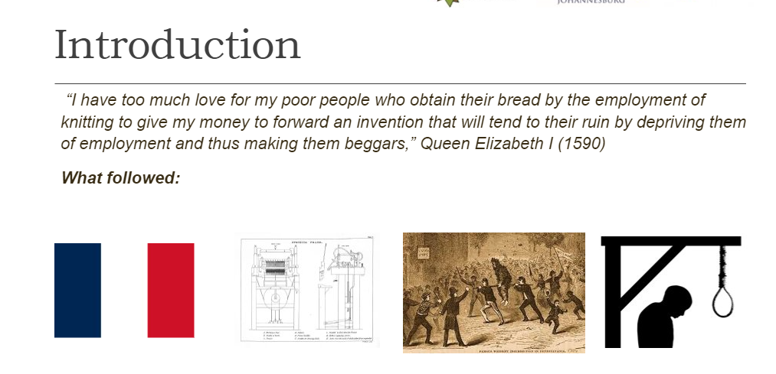

Slide 3
Political factors
Industrial relations: How labor institutions evolve, changes in the nature of work, new forms of work are emerging and workers’ rights, incomes are compromised.
Trade unions: Strong trade unions protect the interests of vulnerable workers and precarious jobs, and avert inequality, the influence of trade unions is threatened by changes in the forms of work
Educational policy from institutions: Public educational policy should respond to the needs of the workplace and teach 21st century skills, and supportive programmes to keep vulnerable workers in the labor market (Gruen, 2017)
Labor market: power between employers and workers is shifting with new forms of work such as gig work, telework; job market is more competitive, with workers settling for lower wages with no career progression or basic conditions of employment.

Slide 4
Economic factors
Wage inequality: The balance of power causing a higher incidence of wage inequality; rising unemployment due to technology displacement and job polarization.
Employment: Certain jobs are being made redundant, while the demand for certain workers in certain occupations is increasing and new jobs are emerging.
Job Polarization: New technologies have reduced the demand for workers performing easily mechanized routine tasks; Low paid jobs are most affected by job losses associated with new technologies; There is a higher relative demand for jobs that that require greater creativity or manual or interpersonal skills; Jobs in the upper wage bands (that require creativity and problem solving) and lower wage bands (requiring manual labor) are in increasing demand.

Slide 5
Social factors
Job precarity: There is a sense of job and income insecurity.
Satisfaction: Changes in technology have affected the job satisfaction of workers.
Burnout: Changes in technology have resulted in burnout of workers as they try to adapt.
Work life balance : Changes in technology have resulted in a poor work life balance for workers as they try to adapt.
Vulnerable workers: Certain demographic groups, particularly older workers and less technology savvy workers are at risk of job losses due to the changing demands of their jobs.

Slide 6
Social factors
Talent: There are efforts to attract and retain the right talent to fit the new paradigm of jobs.
Career: There is a need for constant career development to meet the changing demands on workers.
Leader’s values: Leaders’ values should respond to the needs of the organization and workers amidst the changing technological environment.
Corporate social responsibility: Companies have a responsibility to engage in good governance, fair business practices and investment into developing their workforce and ultimately contributing to the talent pool of the market.

Slide 7
Technological
Gig work: Gig workers fall within the classification of new forms of work, where workers have no long term formal contractual arrangements with an employer and operate as contractors to fulfill very specific roles or tasks.
Telework: Refers to the ability to away from a formal, physical workplace. This form of work has become much more widespread since the start of the global Covid 19 pandemic.
Automation: This phenomenon refers to the ability for jobs or tasks to be completed partially or fully by technology.
New forms of work: ‘New forms of work’ is an umbrella term that describes how traditional working arrangements are changing and relates to the place, time and nature of work, as well as the contract between worker and employer.
Crowd work: Individuals outside of the organization can pitch to fulfil projects or roles.

Slide 8

Technological
Innovation: Refers to changes in processes and systems that allow organizations to deliver products and services more efficiently and effectively.
Digital Transformation: Refers to changes in the industry and organizations brought about by new digital technologies.
E-HRM: Refers to changes in how the HR function is managed through digital technologies.
HR Analytics: Data analytics can be used to monitor worker data and track performance. This is unsettling to workers and may lead to violations of worker privacy.
Virtual HR: HR functions can be delivered effectively through employee self-service portals and other electronic mechanisms.

Slide 9
Job susceptibility
Jobs are at risk.

Slide 10
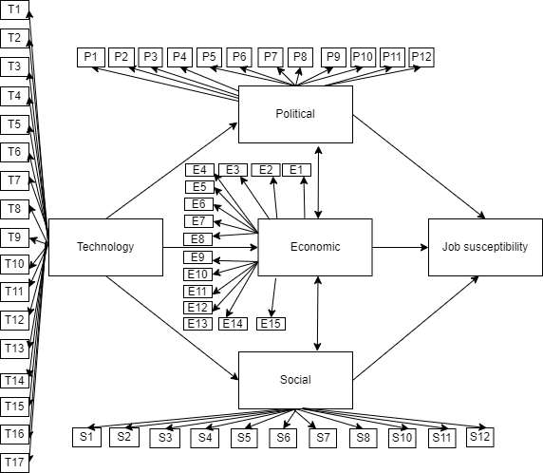

Slide 11
Broadcasting sector
The distribution of audio and video content to a large audience.
Television
Radio
Online streaming services.
Wide range of players:
Broadcasters, production studios, distribution companies, and advertisers.
The sector is constantly evolving as technology changes and new competitors enter the market

Slide 12
Demographics
 |  | Frequency | Percent
Valid | Male | 100 | 48.5
 | Female | 100 | 48.5
 | Prefer not to say | 6 | 2.9
 |  | Frequency | Percent
Valid | Matric or below | 13 | 6.3
 | Diploma | 56 | 27.2
 | Degree or honors | 104 | 50.5
 | Masters | 31 | 15.0
 | PhD | 2 | 1.0
 | Min | Max | Mean | Std. Deviation
Age (Years) | 21 | 56 | 31.71 | 7.02
Years of experience | 0.5 | 35.0 | 6.77 | 4.86

Slide 13
There are adequate job opportunities
 | Average score | StdDev | Count
Content creator (e.g. producer, script writer, reporter...) | 3.69 |  | 55
Human Resource Practitioner | 3.71 |  | 21
Management | 3.57 | 0.99 | 23
Presenters & anchors (e.g. actors, artists, presenters, contributors, anchors...) | 3.60 |  | 55
Technical (e.g. engineers, cameraman, lights...) | 3.48 |  | 52
Notes:
This means across the board from technical to management to presentors, there is more uncertainty about the availability of jobs in the market. One must distinguish between the sector and other sectors concerning this result.

Slide 14
Workers feel a sense of job insecurity.
Content creator | 3.84
Presenters & anchors | 4.09
Technical | 3.85

Slide 15
Jobs are at risk
 | Jobs are at risk. | StdDev
Content creator (e.g. producer, script writer, reporter...) | 3.76 | 0.74
Human Resource Practitioner | 4.19 | 0.75
Management
Presenters & anchors (e.g. actors, artists, presenters, contributors, anchors...) | 4.04 | 0.77
Technical (e.g. engineers, cameraman, lights...) | 3.50 | 0.67

Slide 16
Fair wages
 | Contract/freelance workers. | Permanently employed workers
Content creator | 3.35 | 3.42
Human Resource Practitioner | 4.14 | 4.19
Management
Presenters & anchors | 3.22 | 3.36
Technical | 3.19 | 3.69

Slide 17
Certain occupational types are becoming redundant
Content creator | 3.73
Human Resource Practitioner | 4.05
Management | 3.78
Presenters & anchors | 3.73
Technical | 3.46

Slide 18
New occupations are emerging
Content creator | 3.872727
Human Resource Practitioner | 4.047619
Management | 3.652174
Presenters & anchors | 3.745455
Technical | 3.615385

Slide 19
Education is adapting to respond to the changing education and skills demands in the sector
 | Private | Public
Human Resource Practitioner | 4.38 | 4.00
Management | 3.52 | 3.70

Slide 20
The job market has become more competitive.
Content creator | 3.89
Human Resource Practitioner | 3.95
Management | 3.78
Presenters & anchors | 3.76
Technical | 3.46

Slide 21
I have the capacity to adopt emerging technologies to fulfill my job role
Content creator | 4.16
Presenters & anchors | 4.04
Technical | 3.60

Slide 22
Older or less technology savvy workers feel insecure in their jobs
Content creator | 3.84
Presenters & anchors | 4.07
Technical | 3.90

Slide 23
Findings and conclusion
The responses indicated a sense of job and income insecurity
These conditions can all contribute to job susceptibility
Job insecurity, can make workers more willing to accept less desirable job conditions, such as lower pay, longer hours, or fewer benefits
Income insecurity can make workers more willing to accept any job that offers some income, regardless of the quality of the job or the conditions under which they work.
These conditions also have implications for burnout and job satisfaction

