Slide 1

The issues, challenges and impacts of implementing machine learning in the financial services sector: An outcome of a systematic literature review
Siphiwe Mndebele and Thembekile Mayayise

Slide 2

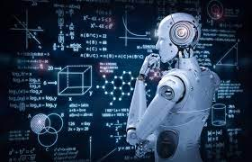
Outline
Background
Literature review
Methodology
Findings
Questions

Slide 3

Background
Machine learning (ML) involves the capability of systems to use curated algorithms to iteratively learn by training available data sets to establish patterns and make predictions about new data.
Since the inception of machine learning in the early 1950s, it has gained so much prominence.
ML draws from various fields such as statistics, artificial intelligence, analytics, and optimisation studies. Its use extends to engineering, manufacturing, agriculture, commercial and social settings.
The adaptability of machine learning algorithms facilitates the generation of insights from a variety of complex and very large data sets, and this has promoted the adoption of machine learning across a variety of fields.

Slide 4

Research Objectives
To uncover the extent to which machine learning has been researched in the context of the issues, challenges, and impacts of implementing ML in the financial services sector and to identify potential areas for future research.
Explore the different implementations of ML techniques in the financial services sector to identify, analyse and evaluate the issues, challenges, and impacts of implementing those machine learning models/techniques.
Research Questions
What are the issues, challenges and impacts of implementing Machine Learning in the financial services sector?
Sub-Questions
In what financial business contexts are ML technologies implemented?
What ML methods/techniques are implemented in each financial business context?

Slide 5
Literature Review
Implementing ML is important, especially when financial services institutions require the necessary analytical capability, as the implementation is likely to impact every aspect of their business model.
In certain financial services environments, unsupervised ML is often used to explore the complex input data from their clients’ loan records, where regression and classification methods are used to predict key credit risk variables to determine the risk of clients defaulting on loan payments.
Some of the ML challenges include the detection and prevention of credit card fraud .
Evidence of studies is growing in understanding the application of various machine learning techniques to predict things such as bankruptcy of clients and businesses, as well as research into the use of ML methods to evaluate risk assessment in the banking sector.

Slide 6

Methodology
Inclusion and exclusion criteria
Included | Excluded
Scope of coverage: 2013-2022 | Literature published before 2013 and after 2022 is excluded
Exposure of interest: machine learning, business analytics, predictive analytics, artificial or business intelligence with a specific focus on machine learning | Non-Machine learning-related content
Language: English | Non-English written
Source of literature: scholarly books, journal articles, conference proceedings, and grey literature, including dissertations and theses | Any literature not in the form of scholarly books, journal articles, conference proceedings, and grey literature, including dissertations and theses.
Study Design: include quantitative, qualitative, and mixed-methods studies | Unspecified study design
Databases: Science Direct, ProQuest and Ebsco Host

Slide 7
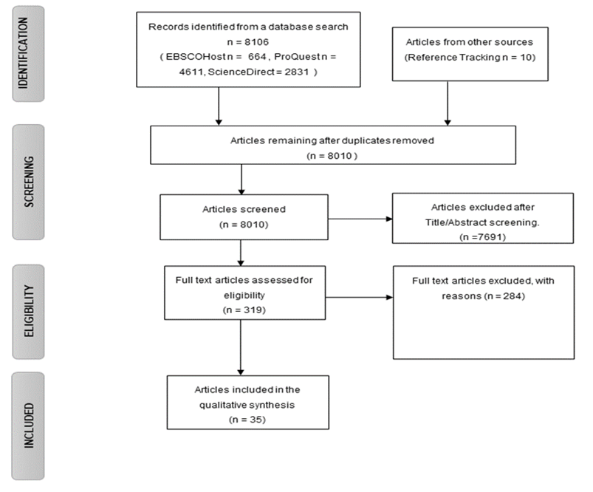
Methodology
PRISMA

Slide 8

Findings

Slide 9
Findings
Machine language uses in the financial services sector.
Bankruptcy(hybrid/support vector)
Fraud Detection(Support vector/neural/hybrid)
Credit Default Prediction(support vector/hybrid/clustering)
Forecasting stock market performance(neural/hybrid)
Risk management(support vector/neural)

Slide 10
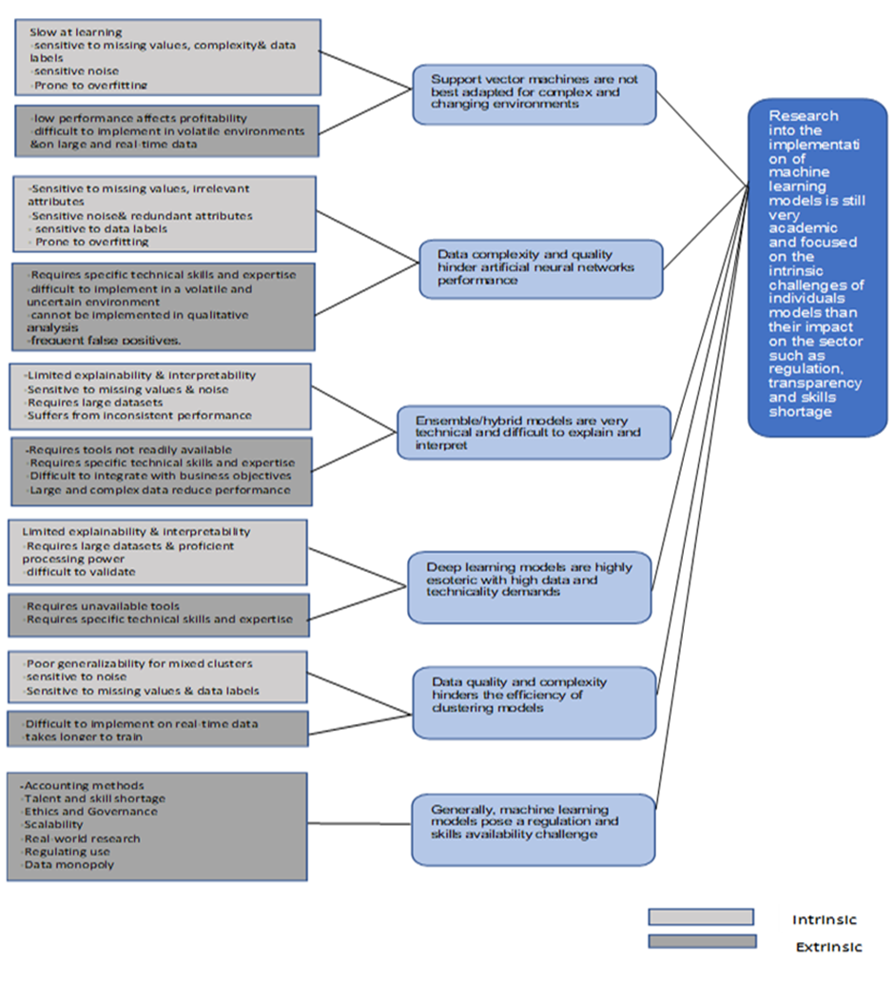
Codes Sub-Themes General theme

Slide 11
References
Marr, B. (2016). What Is The Difference Between Artificial Intelligence And Machine Learning? Forbes. https://www.forbes.com/sites/bernardmarr/2016/12/06/what-is-the-difference-between-artificial-intelligence-and-machine-learning/.
Agavanakis, K. N., Karpetas, George. E., Taylor, M., Pappa, E., Michail, C. M., Filos, J., Trachana, V., & Kontopoulou, L. (2019). Practical machine learning based on cloud computing resources. AIP Conference Proceedings, 2123(1), 020096–1. asn.
Akter, S., & Wamba, S. F. (2016). Big data analytics in E-commerce: A systematic review and agenda for future research. Electronic Markets, 26(2), 173–194. https://doi.org/10.1007/s12525-016-0219-0
Devi, S. S., & Radhika, Y. (2018). A survey on machine learning and statistical techniques in bankruptcy prediction. International Journal of Machine Learning and Computing, 8(2), 133–139.
Drucker, A. M., Fleming, P., & Chan, A.-W. (2016). Research Techniques Made Simple: Assessing Risk of Bias in Systematic Reviews. Journal of Investigative Dermatology, 136(11), e109–e114. https://doi.org/10.1016/j.jid.2016.08.021
Hagen-Zanker, J., & Mallett, R. (2013). How to do a rigorous, evidence-focused literature review in international development: A guidance note. London: Overseas Development Institute.

Slide 12


