Slide 1

The effects of addiction forming dark patterns on lifelong learning
Dr Naomi Isabirye
University of the Witwatersrand

Slide 2
Question and Method
How do addiction forming AI dark patterns affect lifelong learning?
How do AI dark patterns contribute to addictive behavior?
How does Internet addiction affect lifelong learning?
Narrative literature review was applied

Slide 3
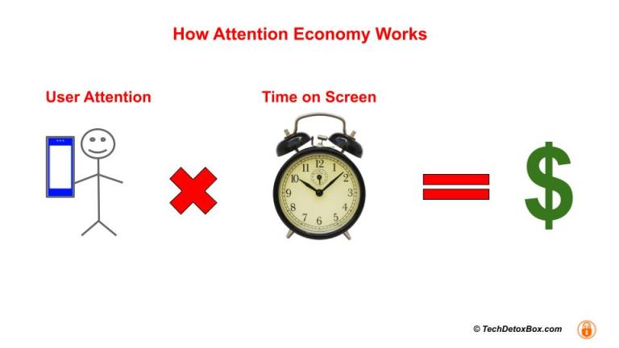

Slide 4
Lifelong learning
What is it?: The continuous, intentional, voluntary pursuit of knowledge and skills
Why now?: 4IR, job displacement, new attitudes required

Slide 5
Lifelong learning traits
  Curiosity, diligence and persistence (Knowles, 1975)
  Grit, perseverance, and diligence (Tough, 2012).
  Diligence, discipline, and time management (Jhangiani and Biswas-Diener, 2017).
  Kolb, D. A. (2014). reflection and diligence in the learning process.
  Motivation, persistence, and diligence (Merriam, Caffarella & Baumgartner, 2007).

Slide 6
Internet addiction
9 hours a day on social media.
Poor sleep, anxiety, depression, and even suicide.
Poor communication and social skills.
Social media addiction can lead to a decrease in academic performance.
Teens who are addicted to social media are more likely to engage in risky behaviors such as drug use and unprotected sex.
Social media addiction can have long-lasting effects on mental health and well-being.

Slide 7
Traits of an Internet addict
Moods
Lack of motivation and interest
Inability to complete tasks
Poor social connections
Loss of control

Slide 8
The problem
Internet addiction
Lifelong learning
Dark patterns

Slide 9




Dark patterns in social media and gaming
Infinite scroll
Notifications
Clickbait
Forced continuity
"Nudge" design

Slide 10

Lifelong Learning | Internet addiction | Dark patterns
Self Driven | Loss of control/autonomy | Designed to take away control
Voluntary | Loss of control
Motivation | Loss of motivation
Intentional | Loss of control/autonomy

Slide 11

Findings and conclusions
Create a sense of urgency or fear of missing out
This can lead to internet addiction
Impedes lifelong learning by reducing the amount of time and energy people have available to engage in learning activities.
Distract users from learning opportunities, as they may find themselves constantly checking social media or other online platforms instead of focusing on educational materials.
Internet addiction can also impair cognitive function, making it harder for people to concentrate and retain information.
By learning to recognize and resist dark patterns, users can take control of their online behavior and avoid falling into patterns of addiction.
Dark pattern principles can be exploited to create better habits for adolescents

