Slide 1




DIGITAL SKILLS FRAMEWORK
Contextualising DSFOne as a unified digital skills framework for South Africa

Slide 2
Agenda
Digital Skills Framework – DSFOne
Consultative research project: Shared understanding of “digital skills”
Round Table discussion: Stakeholder perspectives on potential value and application
2

Slide 3
National Digital and Future Skills Strategy
Introduction & Context
Funding for Digital Skills
Role & Function
Co-ordination Across Government
Research & Monitoring Digital Skills
Building Digital Skills Awareness
Creating Society 4.0
Skills for Industry 4.0
The NDFSS presents a vision for the future of South Africa in which digital capabilities of all citizens are developed by embracing current and emerging technologies
Digital Futures & Mastery
Digital Foundations
Enabler of the NDFSS
3

Slide 4
1
DSFOne

Slide 5
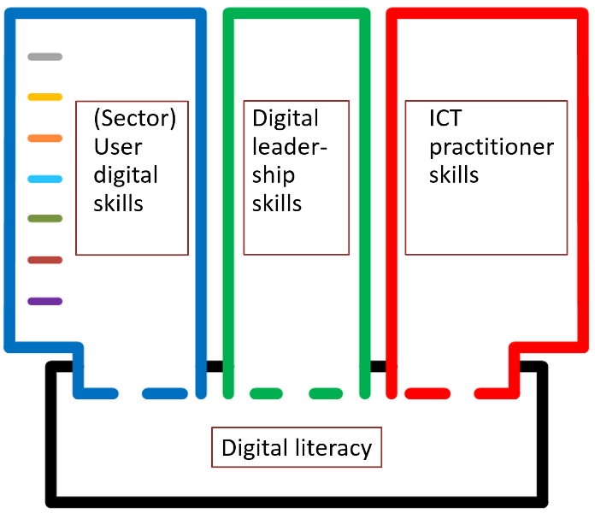
Introduction to DSFOne
Initiated in 2013
Unified framework to incorporate multiple sectoral perspectives on digital skills
Locally relevant
Positioned within the international discourse on digital skills frameworks
DSFOne
DSFOne documentation: https://www.wcapecolab.org/dsf1

Slide 6
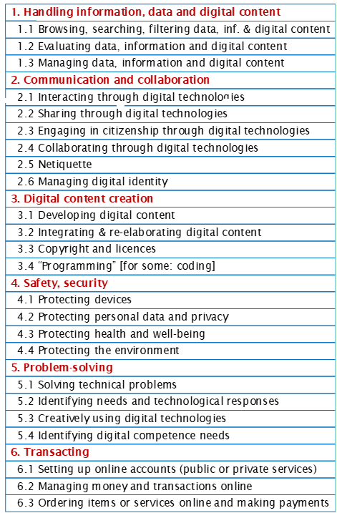
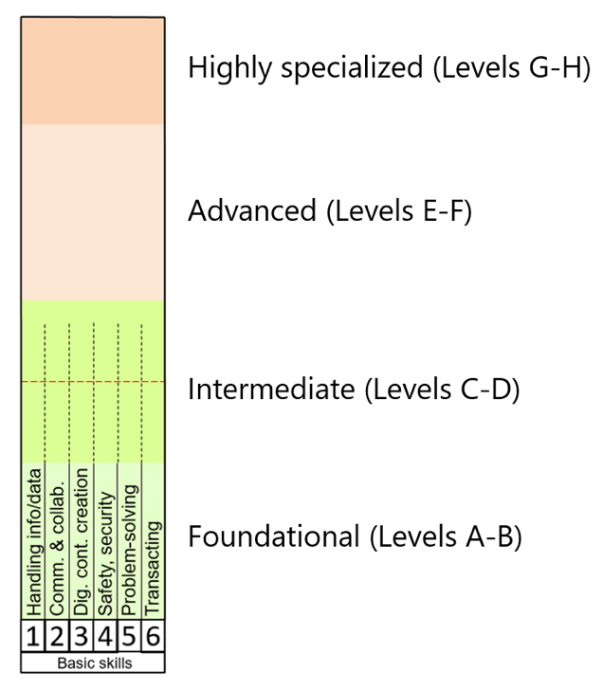
Digital Skills Defined: Six Competency Areas
DSFOne
8 Proficiency Levels

Slide 7
Digital Skills: From Basic to Advanced
Two integrated frameworks
DSFOne

Slide 8
Key characteristics as Unified Framework
Digital Competence as foundational building block
Application within 4 segments or ecosystems:
  Digital Literacy (for work and life – work readiness skills)
  ICT Practitioner Skills
  Advanced digital user skills as these relate to work sectors/industries
  Digital Leadership Competence
DSFOne

Slide 9
2
Project for a shared understanding

Slide 10
Project Intent
Role & Function
The National Electronic Media Institute of South Africa (NEMISA) as one of the key implementers of this strategy,
in collaboration with the University of the Western Cape (CoLab) and
funded by the British High Commission,
wishes to contribute towards the digital skills strategy implementation, by means of initiating a participatory research and consultation process in view of a shared understanding of a national digital skills framework

Slide 11
Project Team
Role & Function
NEMISA:
Trevor Rammitlwa
Antoinette Young
Victoria Tau
University of the Western Cape
Leona Craffert (Dr)
Walter Claassen (Prof.)
Natasha Katunga (Dr)
Carlynn Pokpas (Dr)
Neerali Gajjar
Funder: British High Commission
Gabriel Ramokotjo
Kim Hoffman

Slide 12
Benefits for the Digital Skills Ecosystem
Role & Function
Individuals
Training Providers and Institutions of Learning
Self-evaluation of competence
Awareness of the in-demand digital skills sets
Specification of digital skills requirements for job roles
Gain insights into sector trends and in-demand skills
Structure in-demand digital skills training
Ensure up-to-date and relevant curricula
Employers
Government Agencies
Articulate digital skills requirements for job categories
Guide reskilling / upskilling employees
Guide decision making for strategic skills interventions
Establish a shared understanding and common language
Align standards, policies and strategies
Coordinate development initiatives and development of measurement instruments
Identify gaps; put strategies & interventions in place

Slide 13
3
Round Table Discussion: Stakeholder Perspectives

Slide 14
Round Table Participants:
Mr Andy Searle: Director: Paladin Consulting; Collective X
Mr John April: Director in the Office of the CEO, Quality Council for Trades and Occupations (QCTO)
Prof. Debbie Collier: Dept. of Mercantile and Labour Law, (UWC) and Director of CENTROW
Mr. Mlindi Mashologu Deptuty-Director General, Department of Communication and Digital Technologies
CHAIR: Mr Trevor Rammitlwa
CEO: NEMISA
“… consciously avoids setting out specific digital skills, as such an approach would risk excluding continuously emerging new areas of skills development and new areas of technology application.
”
Digital and Future Skills Strategy
14

Slide 15
THANK YOU

